Slide 1
Vocabulary Words
Lesson 4

Slide 2

Discretion
Noun
Prudence based on sound judgment; caution
The company always uses discretion when dealing with its customers.

Slide 3
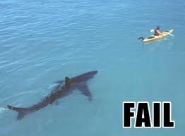
Fiasco
Noun
A total failure
Unfortunately, building a new plant overseas proved to be a fiasco for the automaker.

Slide 4
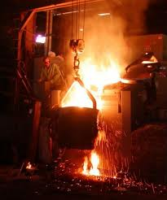
Foundry
Noun
A place where metals are cast
The machine parts were shipped from the foundry to the assembly plant.

Slide 5

Franchise
Noun
The right or license to market products in a specific territory granted by a company to one or more individuals
Sue was granted a fast-food franchise.

Slide 6
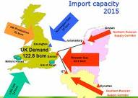
Import
Verb
To bring in goods from another country
The United States will import many luxury items from France this year.

Slide 7
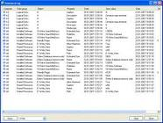
Inventory
Noun
A detailed list of possessions; a periodic survey of goods in stock
The department store conducts its annual inventory of remaining stock in January.

Slide 8
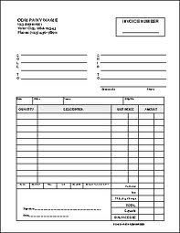
Invoice
Noun
A bill; a list of purchased goods in stock
Bob paid each bill as soon as he received an invoice.

Slide 9
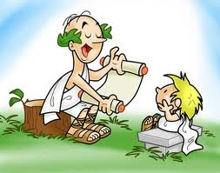
Mentor
Noun
A wise and trusted teacher
The arrogant young executive told the director that he did not need a mentor.

Slide 10
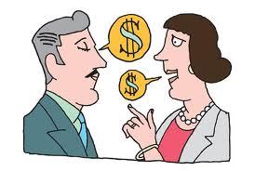
Negotiate
Verb
To discuss in order to come to an agreement; to bargain
The employees hired a lawyer to negotiate a fair agreement with management.

Slide 11
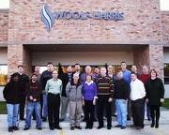
Personnel
Noun
Employees; staff
The young man’s combative nature made him unsuitable for work in personnel management.

Slide 12
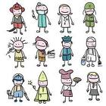
Profession
Noun
Occupation; vocation
The doctor’s son was destined to enter the medical profession.

Slide 13
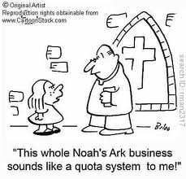
Quota
Noun
An allotment; a required share
She met the January sales quota by the end of the month.

Slide 14
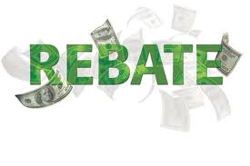
Rebate
Noun
A returned percentage of a payment
With the manufacturer’s rebate, Anne will be able to buy a new car.

Slide 15
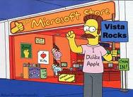
Retail
Verb
To sell items to consumers, usually in small quantities
A shopkeeper can buy large amounts of merchandise at wholesale and then retail it for a profit.

Slide 16
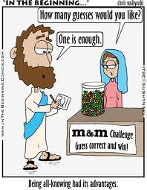
Shrewd
Adjective
Knowing; astute
The financier’s shrewd dealings on Wall Street soon made him famous.

Slide 17
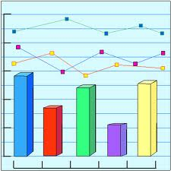
Statistics
Noun
A collection of numerical data
This month’s employment statistics brought encouraging news to recent college graduates.

Slide 18
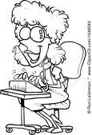
Stenographer
Noun
A person skilled in writing and transcribing shorthand
The stenographer had difficulty remaining alert as the president dictated.

Slide 19
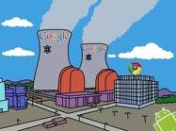
Subsidiary
Noun
A company that has its controlling interest owned by another company
The small publishing firm is a subsidiary of the huge conglomerate.

Slide 20
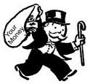
Syndicate
Noun
A group of individuals or organizations combined to carry out specific transactions
Local bankers formed a syndicate to underwrite the project.

Slide 21
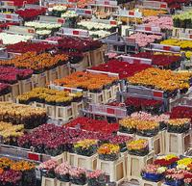
Wholesaler
Noun
One who sells goods in large quantities, usually to a retailer
The grocer buys produce from a wholesaler and then sells it to customers.

