Slide 1
Vocabulary Words
Lesson 5
Containers and Contents

Slide 2
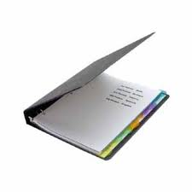
Binder
Noun
A notebook cover with rings or clamps for holding paper
Liz kept all her notes from history class in a three-ring binder.

Slide 3
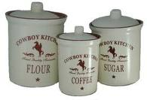
Canister
Noun
A container for holding dry foods
The little girl opened the canister and dumped flour on the kitchen floor.

Slide 4
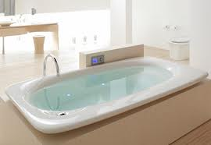
Capacity
Noun
The full amount that can be contained or absorbed
The faucet has been running for 15 minutes, and the bathtub has reached it’s capacity.

Slide 5
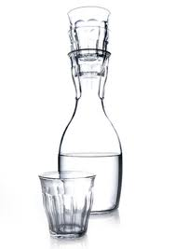
Carafe
Noun
A glass bottle for serving water or wine
Many restaurants sell wine either by the glass or the carafe.

Slide 6
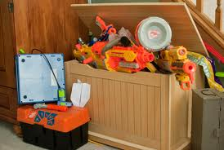
Clutter
Noun
A jumble of things; a condition of disorder
There was such a clutter in the children’s toy box that they could not find the pieces of the puzzle.

Slide 7
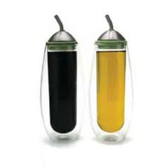
Cruet
Noun
A small glass bottle that holds vinegar, oil, or other condiments
If you like to mix your own salad dressing, the waiter will bring you a cruet of oil and one of vinegar.

Slide 8
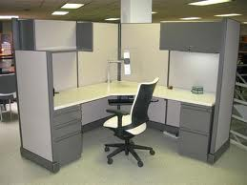
Cubicle
Noun
Any small compartment.
John’s office was just a cubicle, barely large enough for a desk.

Slide 9
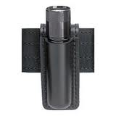
Holster
Noun
A case for a pistol or other object that may attach to a belt.
The night watchman carried a large flashlight in a holster attached to his belt.

Slide 10
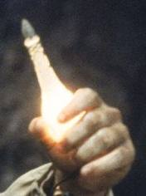
Phial
Noun
A small glass container
The wicked witch pulled the tiny phial from her cloak and poured liquid into a cup.

Slide 11
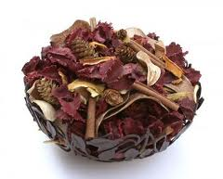
Potpourri
Noun
A mixture of dried flowers and spices kept in a jar and used for fragrance
The potpourri on her dresser made the bedroom smell like a garden.

Slide 12
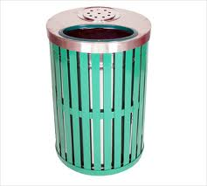
Receptacle
Noun
A container or place to put things
The large basket was meant to be a decoration but became a receptacle for trash.

Slide 13

Replenish
Verb
To fill again
Fortunately, Tom had thought to replenish the wood supply before the cold snap.

Slide 14
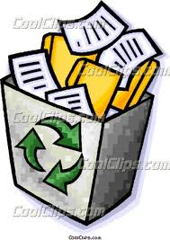
Repository
Noun
A place where things are stored or deposited
The box was intended to be a repository for old newspapers.

Slide 15
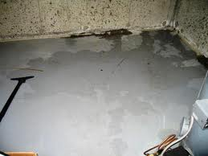
Seep
Verb
To leak gradually; to ooze
Water will seep into a basement through even a tiny crack in the foundation.

Slide 16
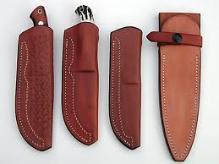
Sheath
Noun
A close-fitting covering for the blade of a knife or sword
On the desk lay a knife in a fine leather sheath.

Slide 17
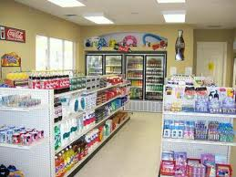
Sundry
Adjective
Several; diverse
A general store stocks sundry times ranging from fabrics to firewood.

Slide 18
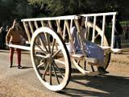
Tumbrel
Noun
A two-wheeled cart used for hauling
The farmer loaded his tumbrel with manure from the barn and then hauled it to the garden.

Slide 19
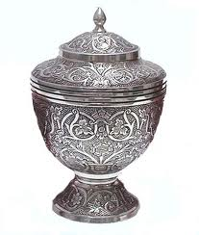
Urn
Noun
A large decorative pot often having an attached pedestal or feet
A ceramic urn was placed at either side of the entryway.

Slide 20
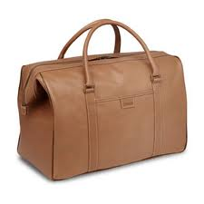
Valise
Noun
A piece of hand luggage
The woman did not check her valise but carried it on the plane herself.

Slide 21
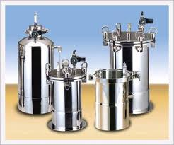
Vessel
Noun
A hollow container for holding liquids
The potter designed a vessel to be used for both hot and cold liquids.

