Slide 1
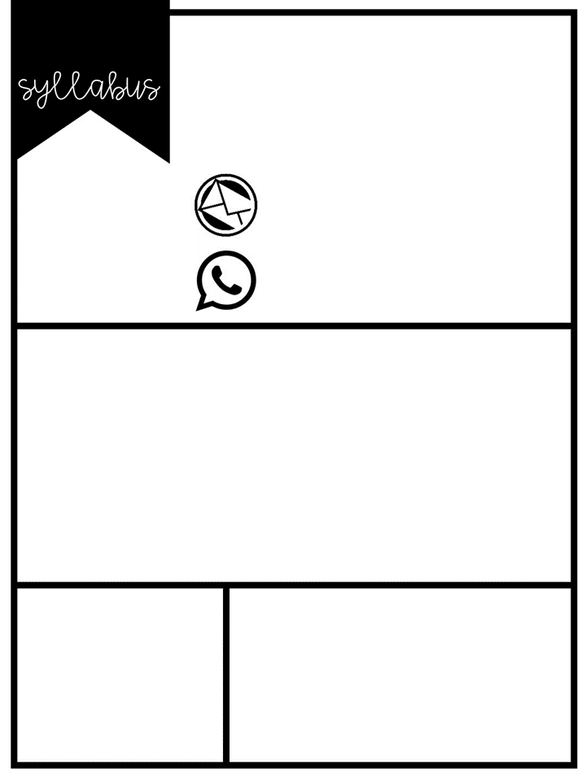
2022-2023
Welcome to 6th Grade Science
Katrina Landwehr
klandwehr@usd263.org
316-777-2022 Ext. 3410
Course Description & Yearly Overview
1st Quarter | Lab Safety Measurement
2nd Quarter | Scientific Method Matter and Atoms
3rd Quarter | Atmosphere Hydrosphere
4th Quarter | Geosphere Astronomy
This year in science, you will learn about the topics listed at the right. As the year goes on, you will use knowledge of the scientific process to complete labs and investigations.
Supplies
About Me
Agenda Book
Chromebook
Composition Book
Green Folder
Pencil, highlighter, colored pencils
This is my 20th year of teaching and my 16th year of teaching science in Mulvane. Although I have taught all subjects, science is definitely my favorite! I got my undergrad degree from Pittsburg State University and my Master’s from Wichita State University. I am married with two children and love crafting, gardening, and reading in my spare time.

Slide 2
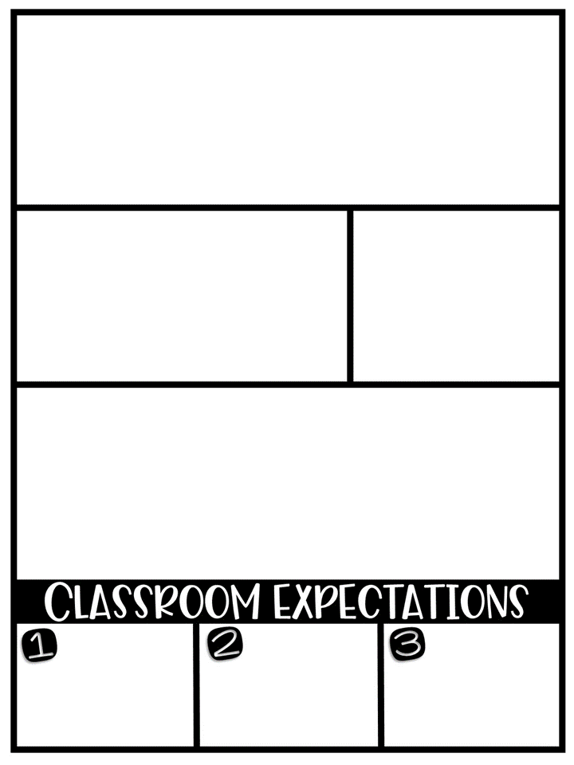
Assignment Expectations
All work that is turned in for a grade must be in pencil to get credit.
You are responsible for completing all work in your Interactive Student Notebook (even if you were absent - look in Google Classroom). You will receive a grade for it at the end of each unit.
You may correct any test, quiz or assignment for half the points back on those questions that you missed. You have one week from when it is handed back to correct it and turn it back in.
Behavior Procedures
Grading Scale
In class, we will create a social contract that will guide how we treat each other in our classroom. It will be posted as a reminder. If it is broken, consequences will include a verbal warning, private conversation and an office referral/parent contact as necessary.
A = 90% - 100%
B = 80% - 89%
C = 70% - 79%
D = 60% - 69%
F = 59% - 0%
Late Work/Extra Credit
All assignments are due by the date listed in Google Classroom (GC). Incomplete work is not accepted. You may turn it in complete the next day for full credit, or up to one week late for a 20% reduction. After one week, the grade remains a zero.
At the beginning of each quarter, you will be given 10 extra credit points. Each time you need to return to your locker, have late work, etc. you will lose a point. At the end of the quarter, any remaining points get added to your grade.
Be prepared!
Give full effort!
Take charge!
Come to class with all materials, including a charged Chromebook.
YOGOWYPI - You Only Get Out What You Put In - You owe it to yourself to do your best!
If you get stuck, ask for help in class, stop by after school, or email me. I want you to succeed!

Slide 3
Please sign and return this page to science class. You may keep the first page for your reference.
I have read Mrs. Landwehr’s 6th grade science syllabus and understand the policies and procedures.
_____________________________
Student Name (printed)
_____________________________ ________
Student Signature Date
_____________________________ ________
Parent/Guardian Signature Date

